Slide 1
Thermochemistry

Slide 2
Thermochemistry
Thermodynamics - study of energy and its transformations
Thermochemistry - study of chemical reactions involving changes in heat

Slide 3
Energy
Energy - the ability to do work or transfer heat energy.
Work - energy used to cause an object with mass to move (w = f x d)
Heat - energy used to cause the temperature of an object to increase

Slide 4
Major Types of Energy
Potential energy - energy an object possesses by virtue of its position or chemical composition.
Kinetic energy - energy an object possesses by virtue of its motion.

Slide 5
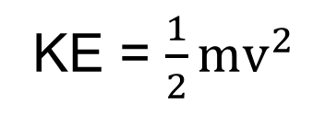
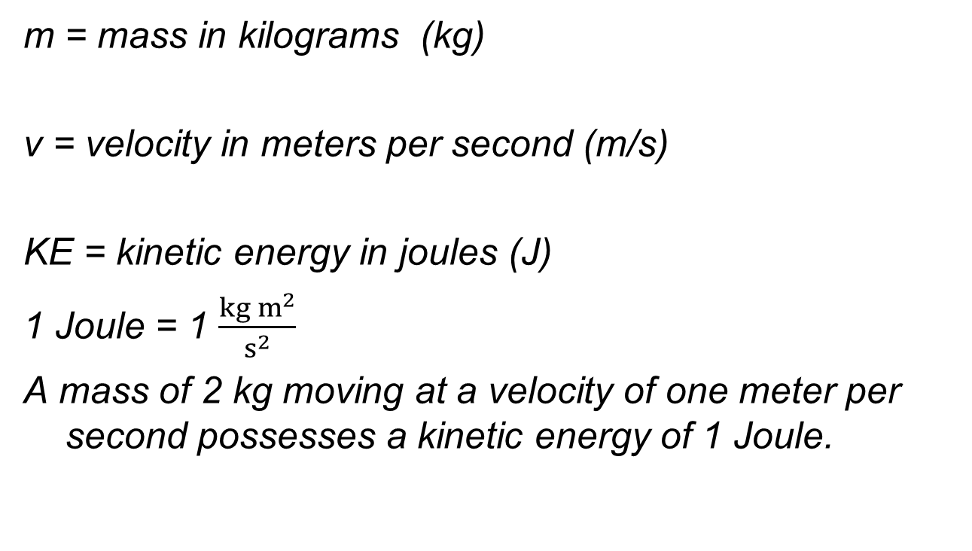
Kinetic Energy

Slide 6
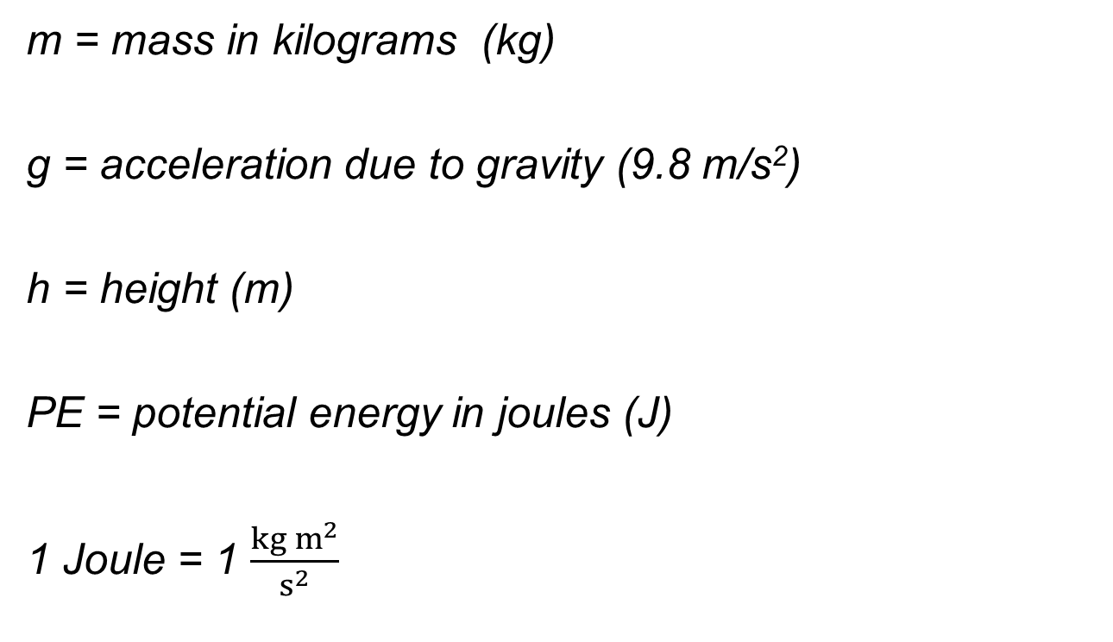
Potential Energy
PE = mgh

Slide 7
Units of Energy

Slide 8
First Law of Thermodynamics
Energy is neither created nor destroyed, but it can undergo a transformation from one type to another. (Law of Conservation of Energy)
The total energy of the universe is a constant.
The energy lost by a system must equal the energy gained by its surroundings, and vice versa.

Slide 9
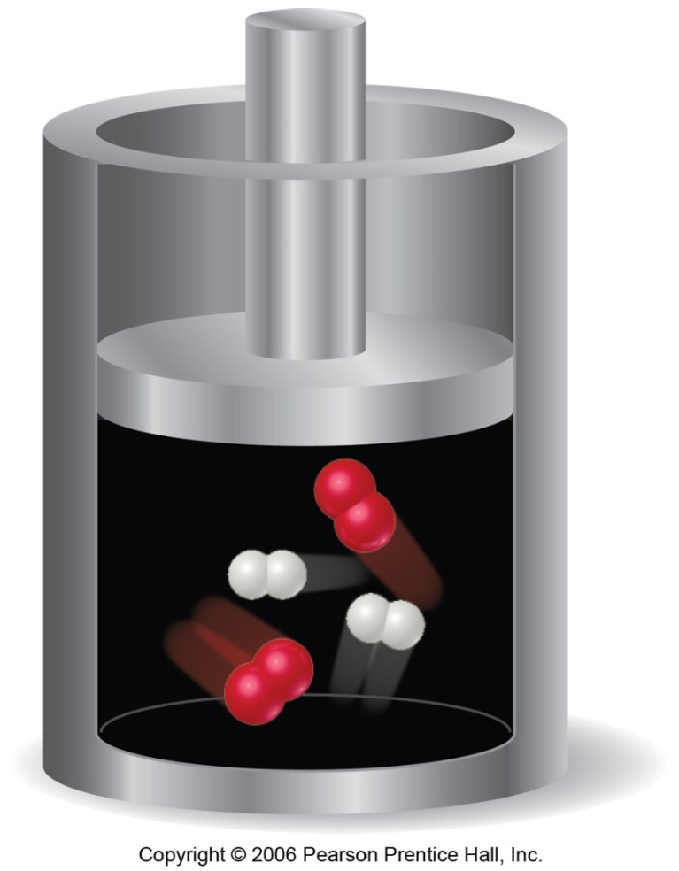
System and Surroundings
System - the molecules we want to study (hydrogen and oxygen molecules).
Surroundings - everything else (cylinder and piston).

Slide 10
Internal Energy
The internal energy of a system is the sum of all kinetic and potential energies of all components of the system; we call it E.
ΔE = E_{final} − E_{initial} (State function)
If ΔE is positive, the system absorbed energy from the surroundings.
If ΔE is negative, the system released energy to the surroundings.

Slide 11
ΔE = q + w
When energy is exchanged between the system and the surroundings, it is exchanged as either heat (q) or work (w).
That is, ΔE = q + w.

Slide 12
The signs of q & w
+ q = system gains or takes in heat
q = system loses or gives off heat
+ w = work is done on the system by the surroundings (piston pushed in)
- w = work is done by the system on its surroundings (piston moves out)

Slide 13
Example
As hydrogen and oxygen gas are ignited in a cylinder, the system loses 550 J of heat to its surroundings. The expanding gases move a pistion to do 240 J of work on its surroundings. ΔE for system = ?
Answer:
ΔE = q + w
ΔE = (-550 J) + (-240 J)
ΔE = - 790 J
What does it mean?
The system gave off 790 J of energy to its surroundings

Slide 14
Enthalpy & ΔH
The symbol for enthalpy is H.
Enthalpy is the internal energy plus the product of pressure and volume:
At constant pressure:
ΔH = ΔE = q
So at constant pressure,
ΔΗ = heat lost or gained by the system
H = E + PV

Slide 15
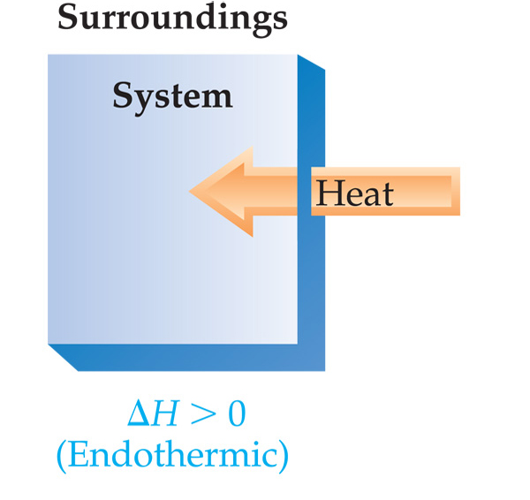
Endothermic
When heat is absorbed (taken in) by the system from the surroundings, the process is endothermic.
ΔH = H_{final} − H_{initial}
ΔH = H_{products} − H_{reactants}
ΔH = positive value
for endothermic

